Slide 1
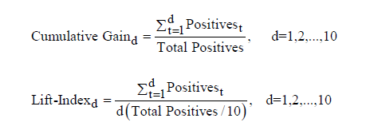
MDS 560 Session 4 Homework Observations
Overall, good progress in going through the Rapidminer learning curve.
A little bit of confusion with:
Recall: proportion of Actual positive cases correctly identified
Precision: proportion of Predicted positive cases correctly classified
Lift Gain: A lift-gain table measures how well a classification system (e.g. logistic model) predicts the
probability of a positive outcome. The data are sorted from highest probability to lowest probability
and grouped into deciles. The primary statistics displayed in the Lift-Gain table are computed as follows:
The lift can simply be thought of as the ratio between the cumulative gain of the classification
system and the cumulative expected gain.

Slide 2
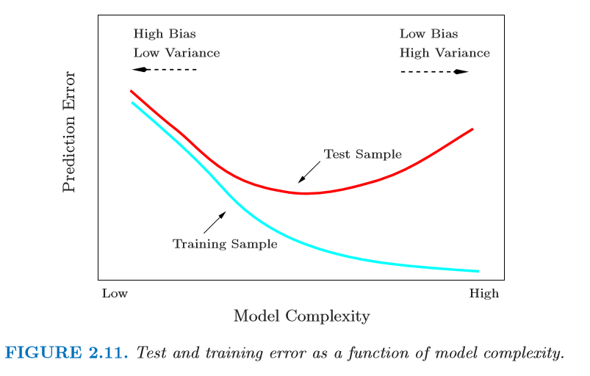
Discussion Board: Problems with Overfitting Indicate the Need for Testing the Model with
Hold Outs, Split Samples, K-Fold Cross Validation
These are a trade-off where underfitting leads to increase in bias and overfitting leads to an increase in variance.
Possible that regularization could make some coefficients 0 making it a dimensionality reduction method.
Other methods LDA, Principle Components, Factor Analysis

Slide 3
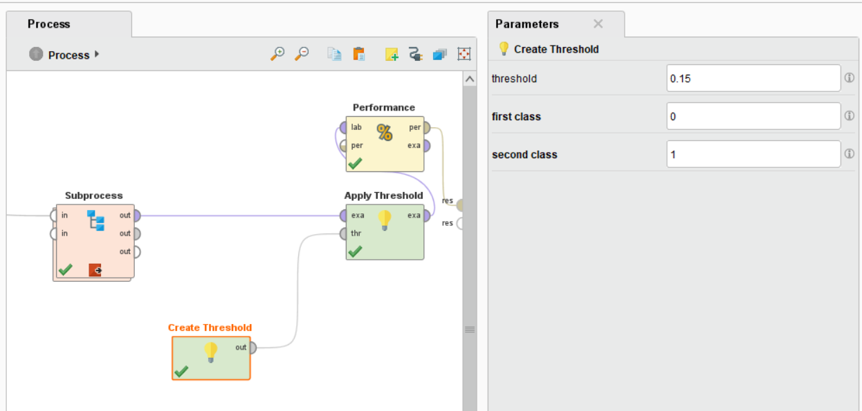
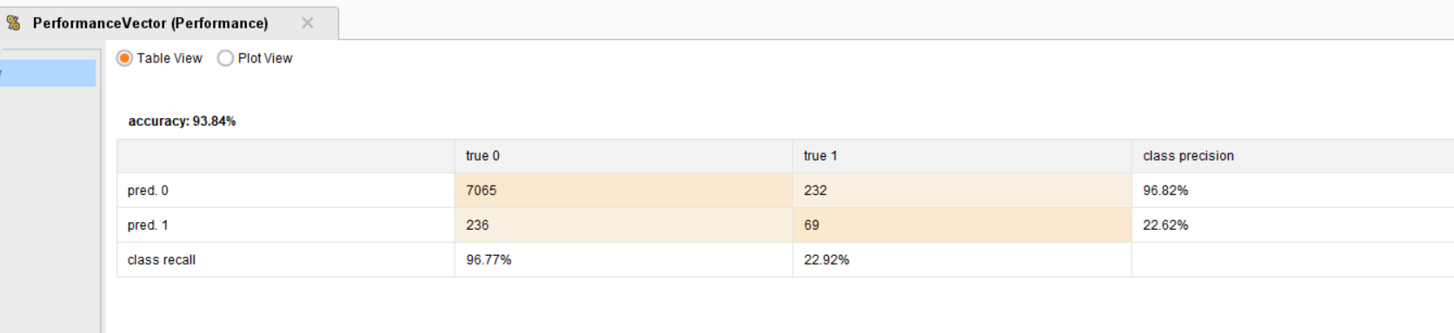
Explore With Training Dataset—All Observations

Slide 4
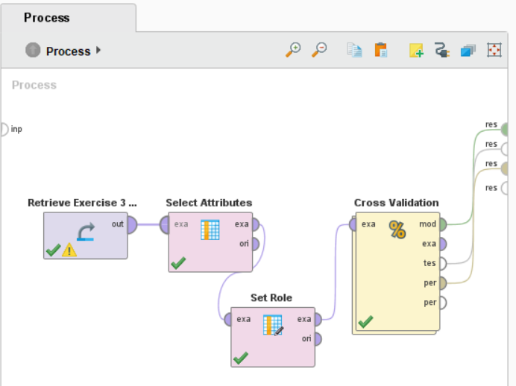
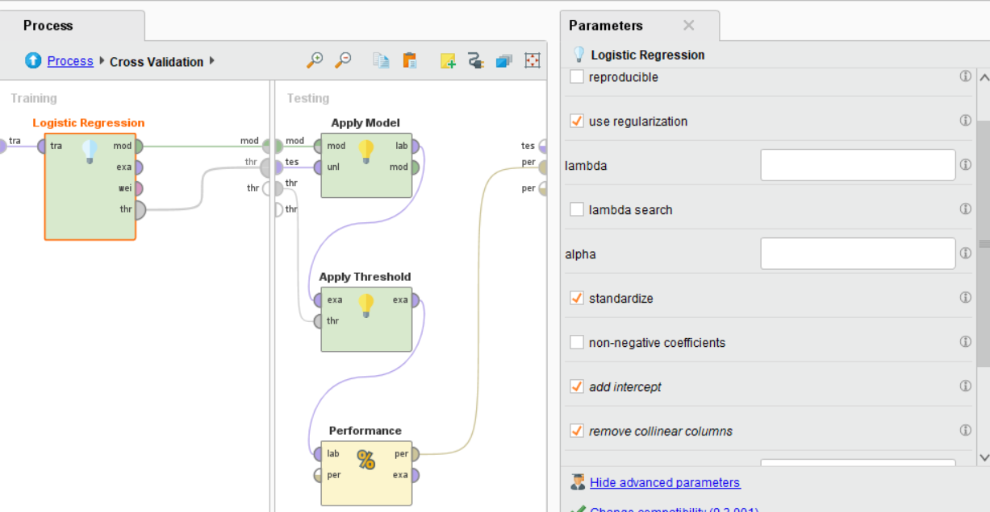
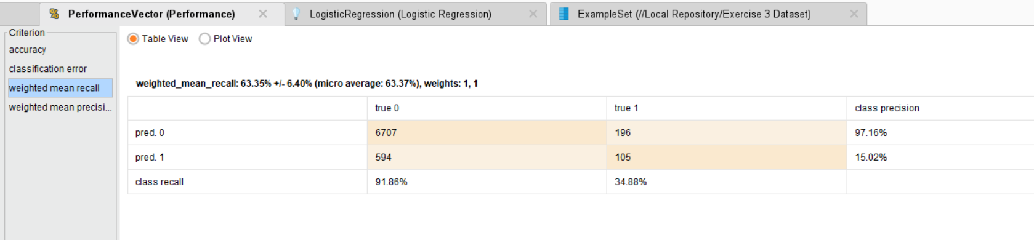
Auto Threshold Finding, Removing Collinear Columns Let Software Find Optimal Threshold—Default is .50

Slide 5
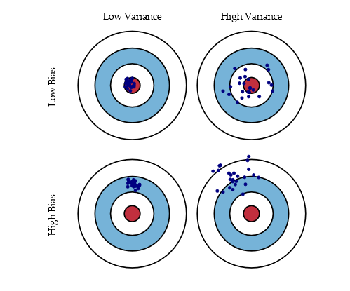
Bias and Variance Discussion
We may choose to accept a small amount of bias if we can reduce variance substantially

Slide 6
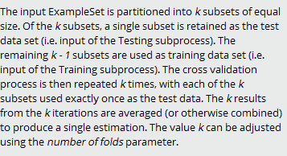
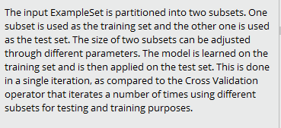
Cross Validation
Split Validation-Hold Outs
Especially good for smaller datasets
Especially good for larger datasets

Slide 7
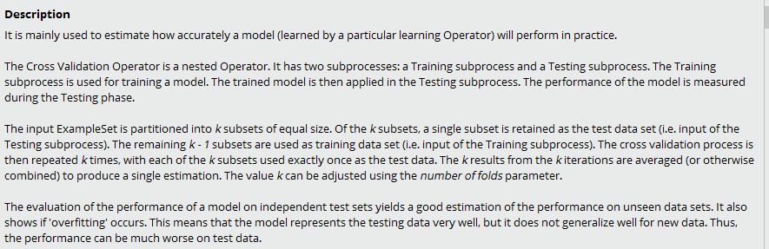
Cross Validation in Rapidminer

Slide 8
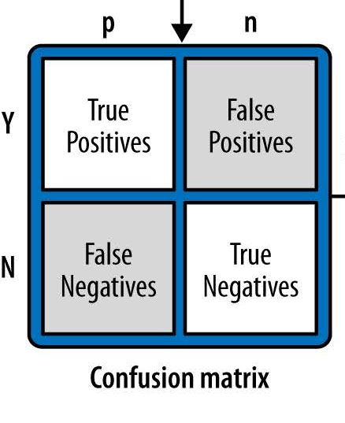
Model Evaluation: Confusion Matrix
Can be Applied to a Test Sample For Validation
Actual training data labels
Proportion of Actual positive cases correctly identified
Proportion of Predicted positive cases correctly classified
Precision
Recall
What the model predicts
Issues
Unbalanced classes: problems using accuracy as a measure, Suggests More Robust Models May be Appropriate
Only 5 out of 1,000 cases are true negatives
Predict all positive: 99.5% accurate but likely useless
Unequal costs and benefits Suggests that Varying the Threshold Could be Useful
Expected value
References: Data Science for Business

Slide 9
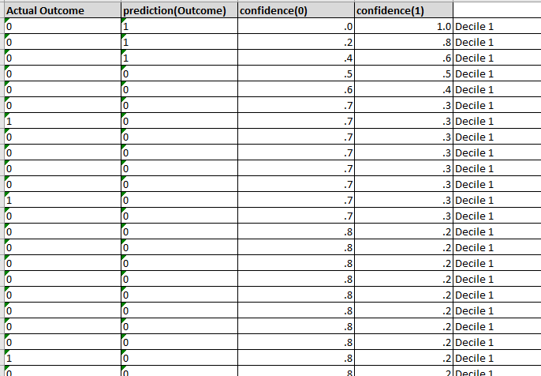
A Sample Lift Calculation by Hand—Test Dataset 3a with 10% Holdout Test Sample
In this case 35 actual 1’s were drawn from
N=760 test observations;
76 observations per decile sorted in descending order by predicted probability from the model.
A Closer Look at Lift

Slide 10
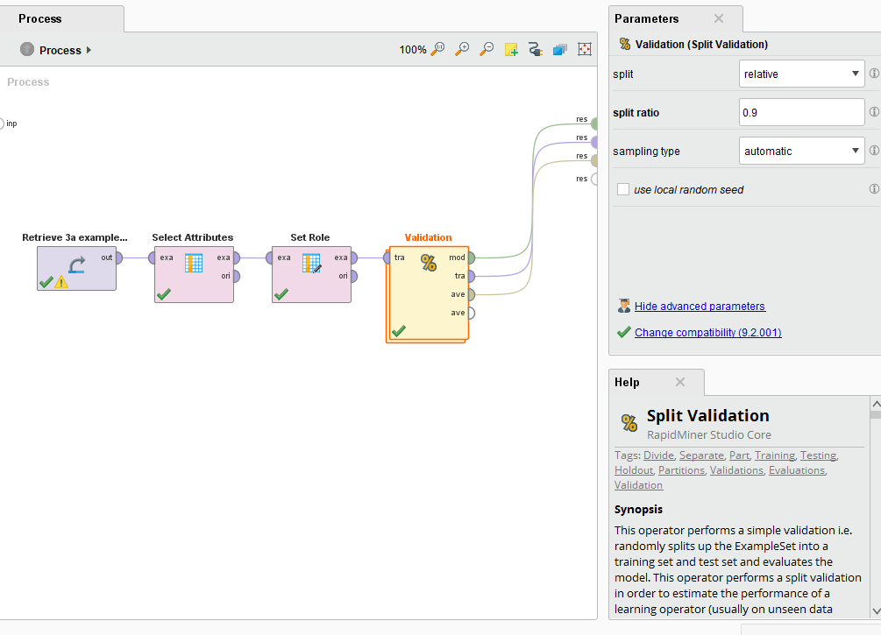
Lift Discussion: Dataset 3a Split Validation
7602 total observation in the dataset
This produces 760 test observations

Slide 11
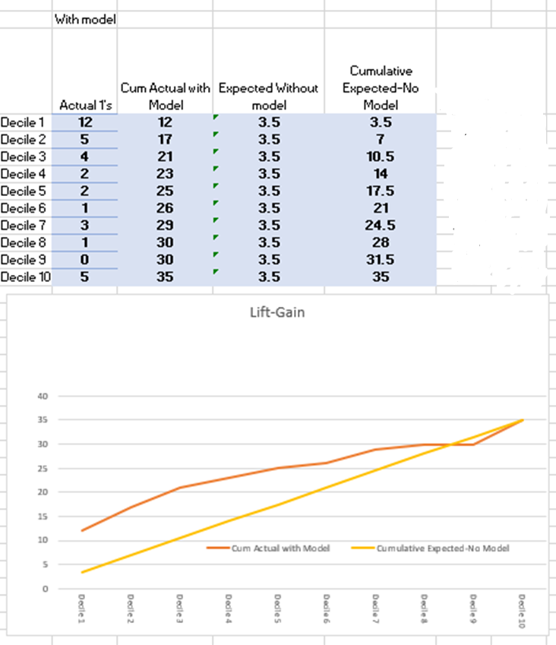
A Sample Lift Calculation by Hand—Dataset 3a, 10% Holdout Test Sample
N=760 observations
76 observations per decile sorted by predicted probability from the model.
In this 10% sample we have 35 actual 1’s
Therefore 3.5 expected per decile.

Slide 12
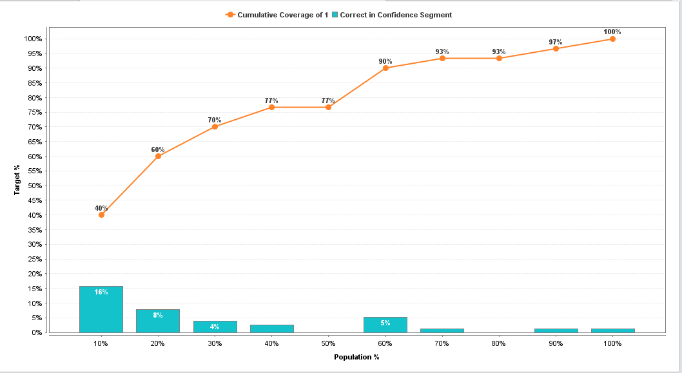
6/35 in decile 2=17%
51%
By Seeing more than 10%, we recognize information gain from the model over no model.
In all cases a “no model” fives us only a 10% for comparison
34%
12/35 in decile 1=34%
12/76 total bin size
in decile 1=15.8%
6/76 total bin size
in decile 2=7.9%
With no model we would have had three 1’s in decile 1
With the model we have 12 1’s in decile 1
Therefore a lift of 12/3=4

Slide 13
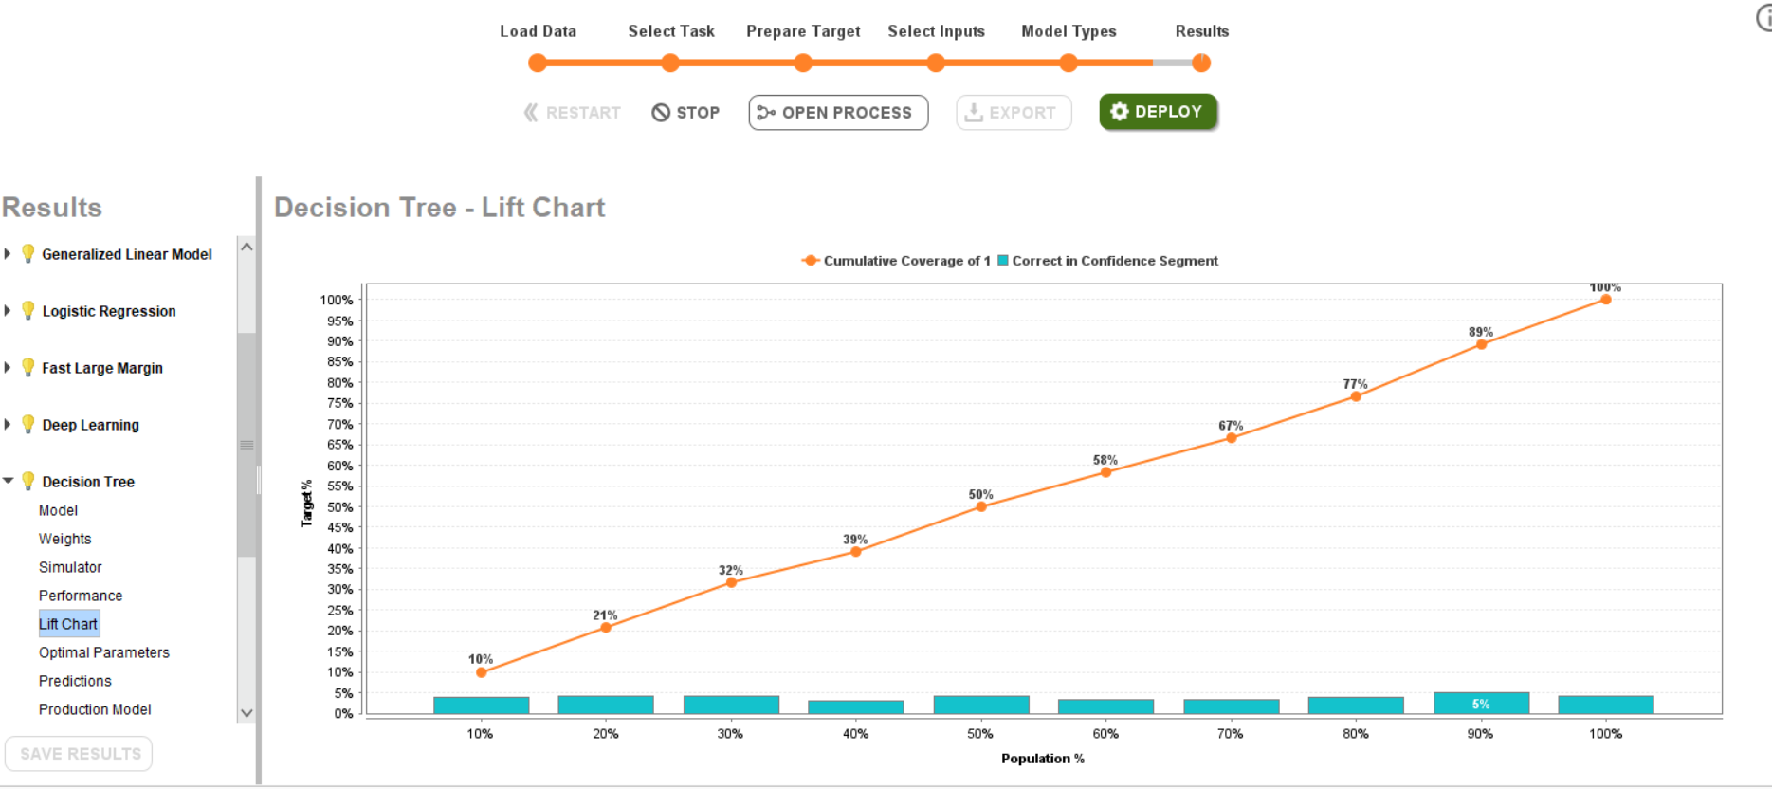
Decision Tree Shows Almost No Gain

Slide 14
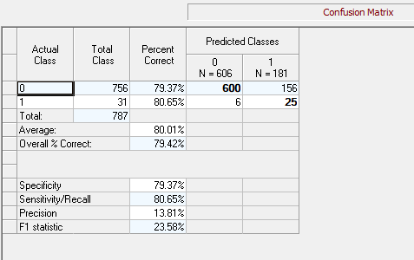
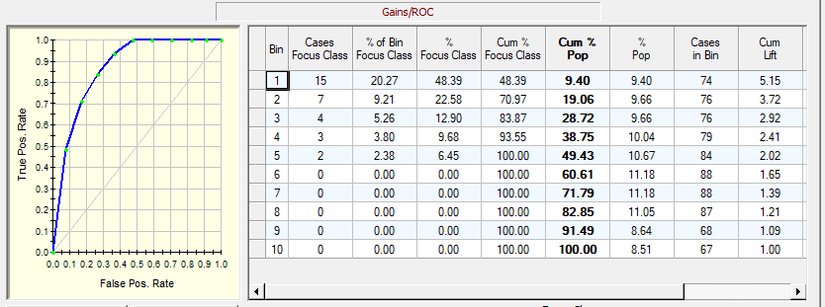
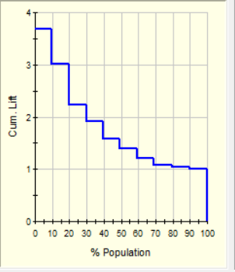
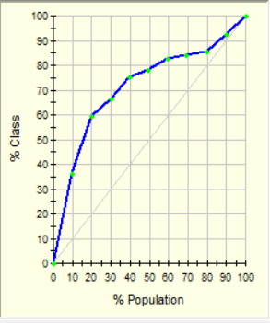
Lift Calc for Decile 1
10% test sample
90% training sample
Gains
A More Traditional Display of Lift From Salford Systems

Slide 15
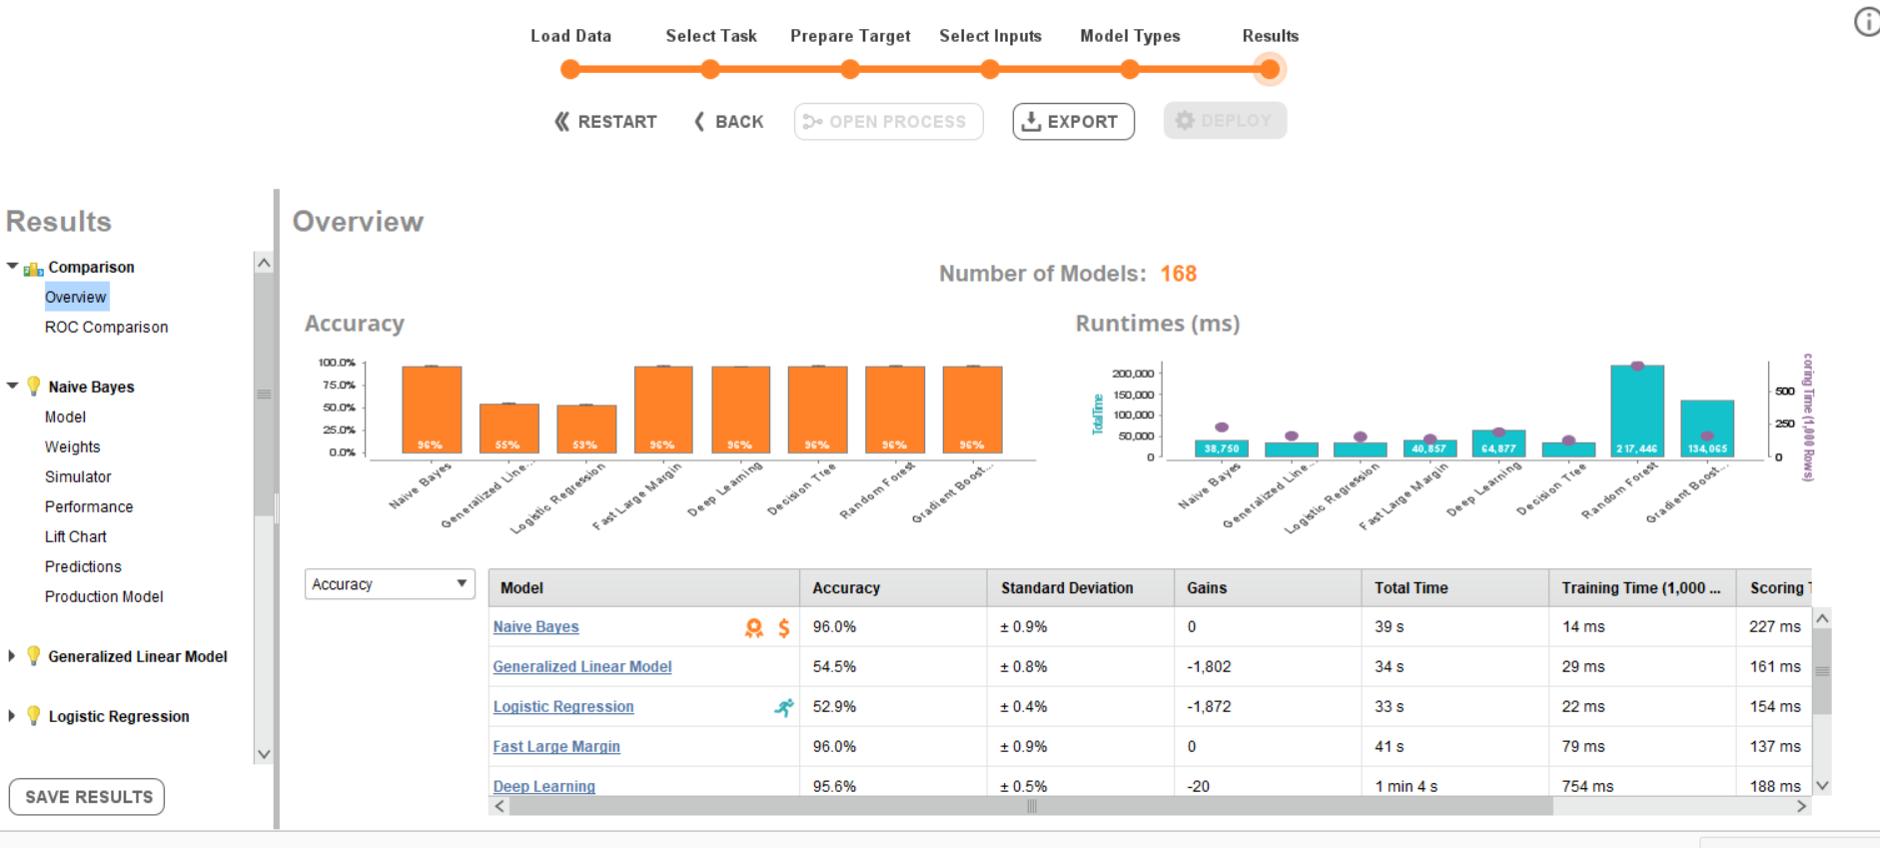

Slide 16
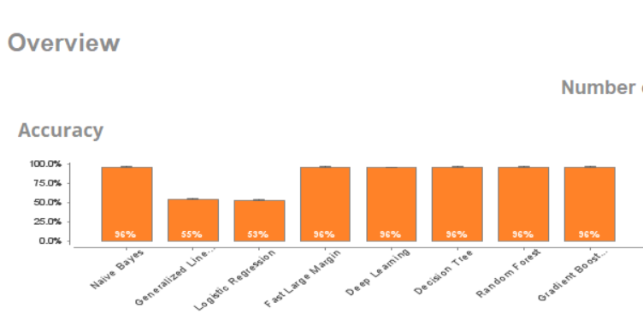
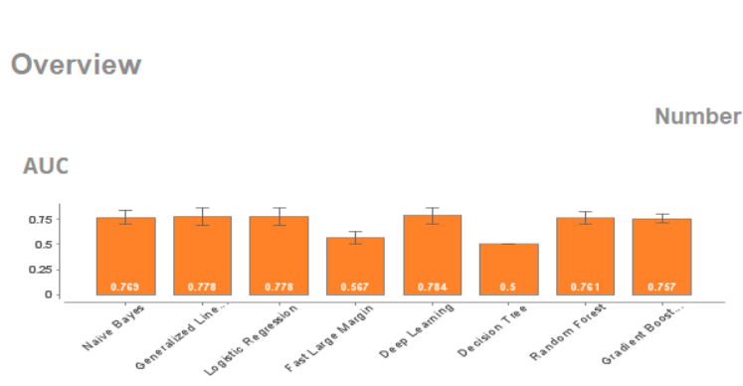
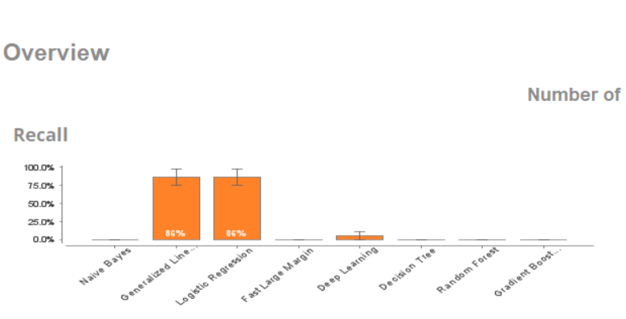
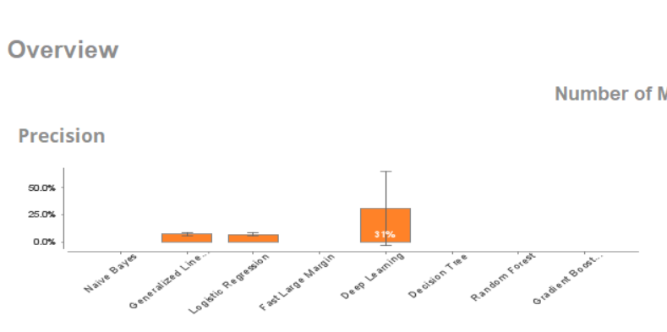

Slide 17
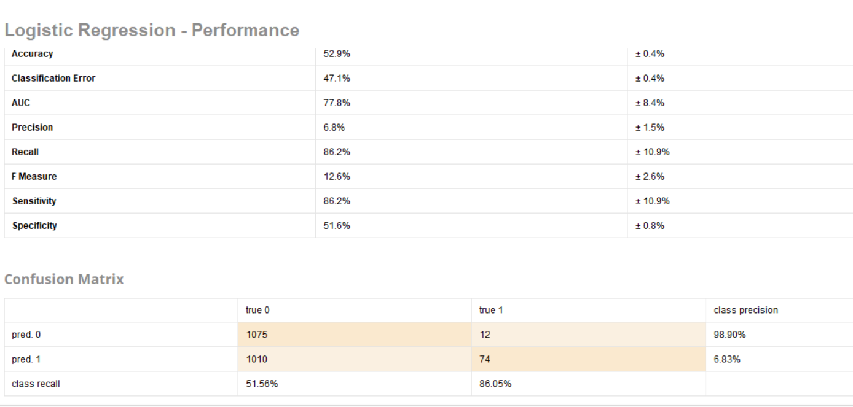
Approx. 30% Holdout (split) Validation in Automodel

Slide 18
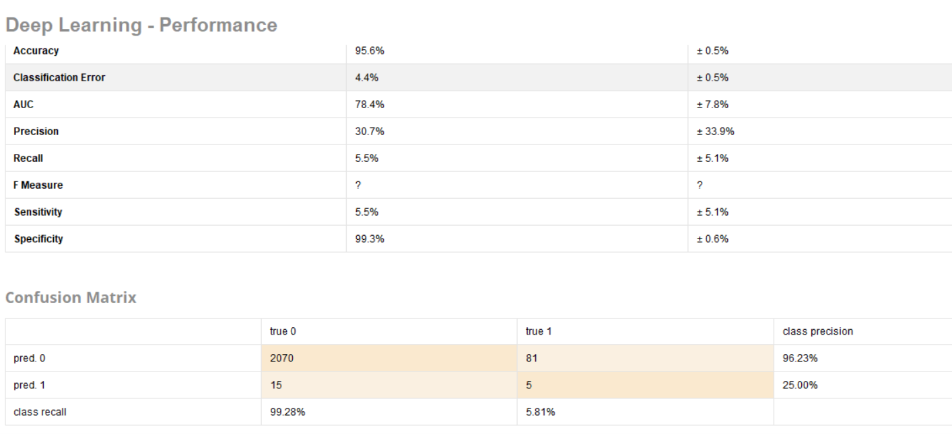

Slide 19
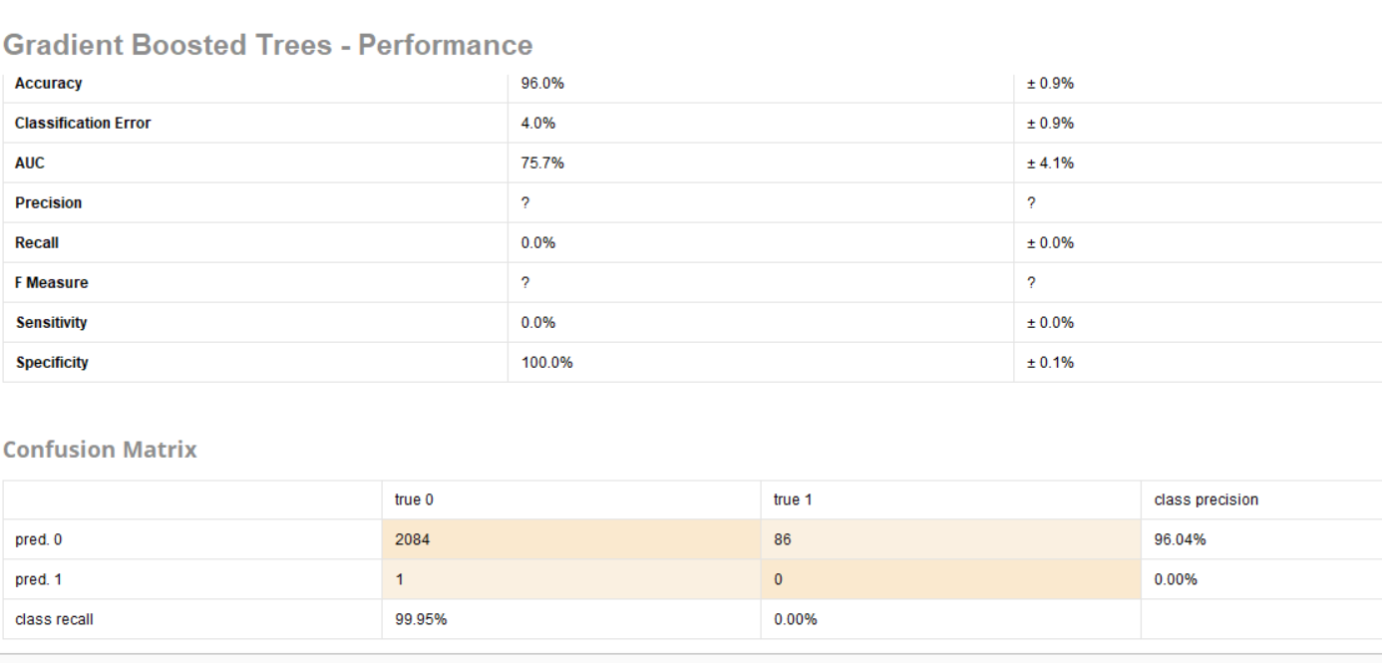

Slide 20
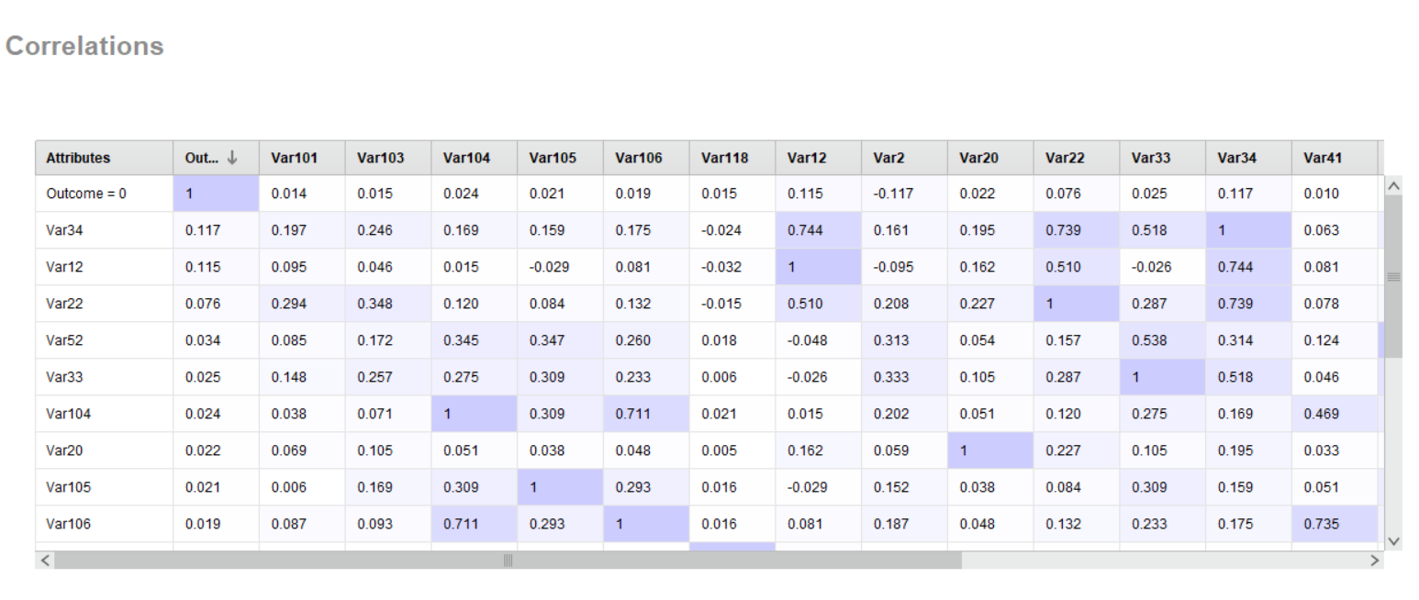

Slide 21
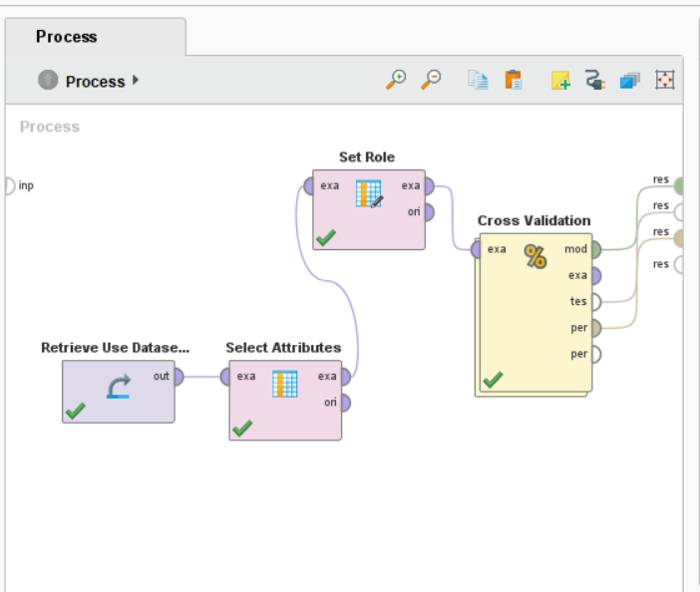
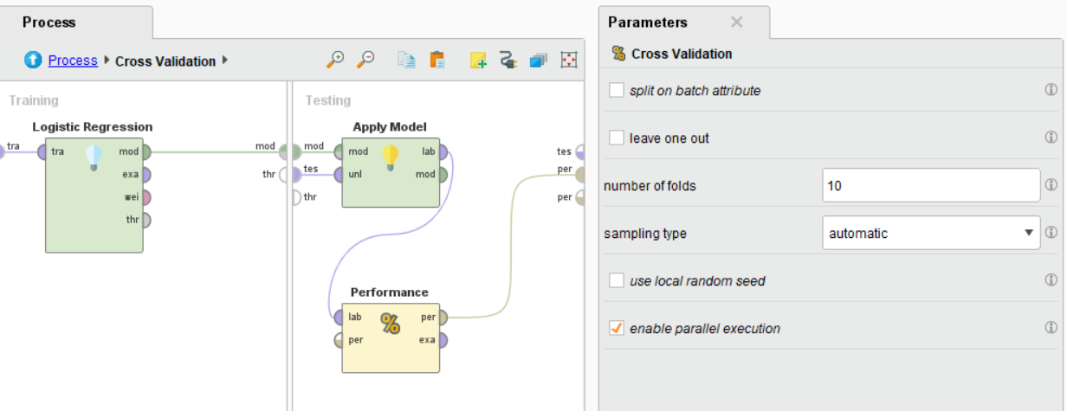

Slide 22
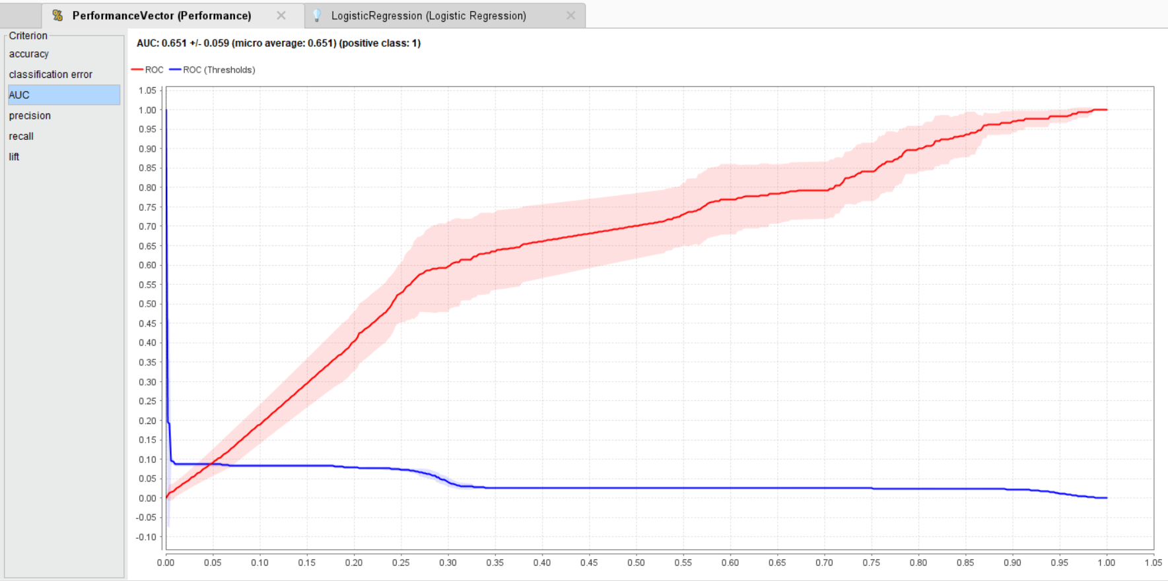

Slide 23
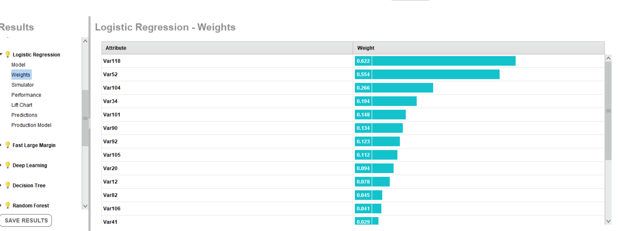

Slide 24
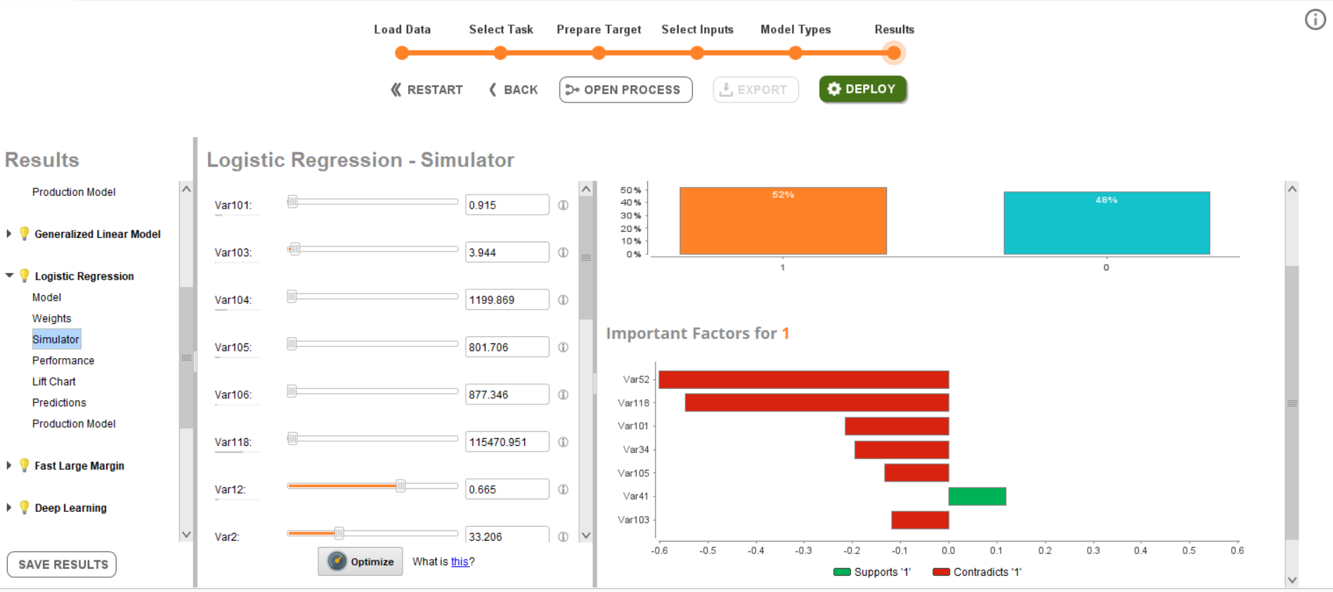

Slide 25
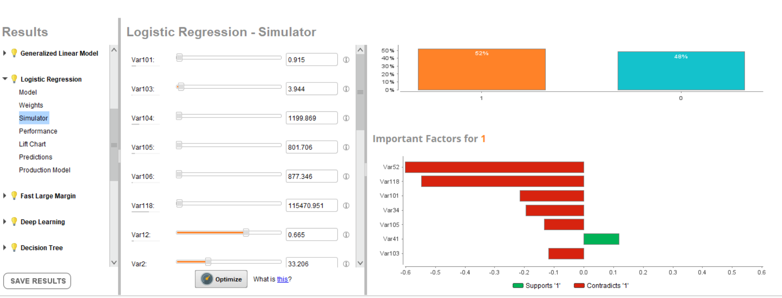

Slide 26
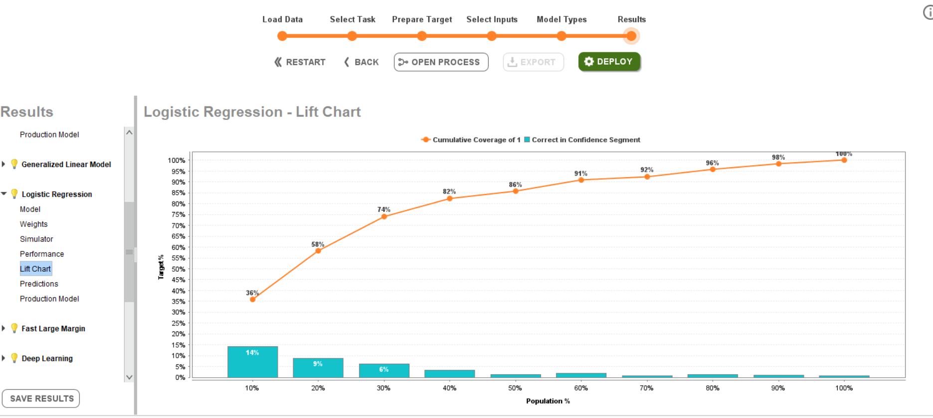

Slide 27
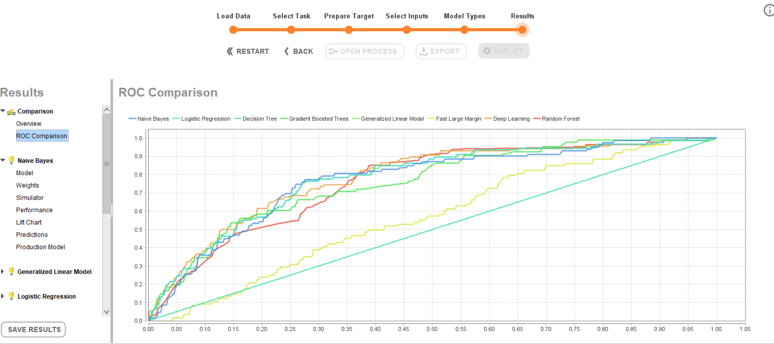
AUC’s Implies there is some value in the model and Different Performance Levels

Slide 28
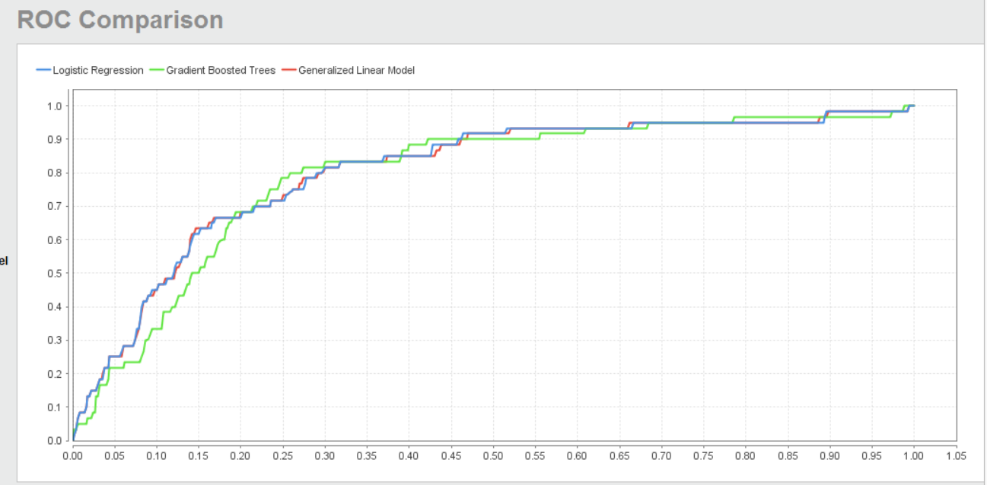
AUC’s Implies there is some value in the model
AUC’s Implies there is some value in the model
No Model

Slide 29
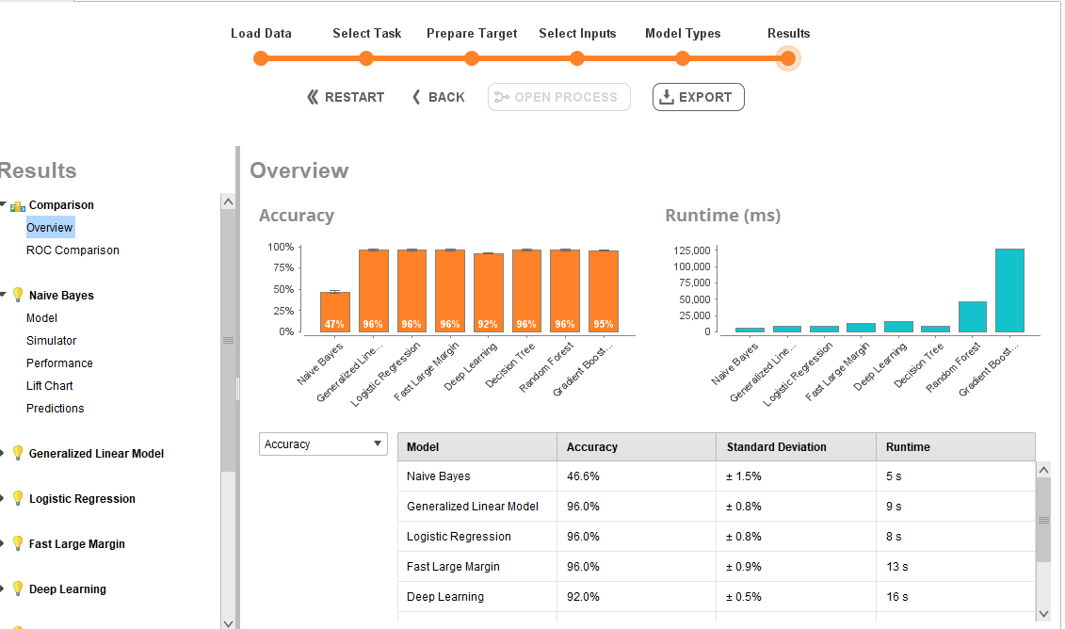
Prior View---Analysis of Dataset 3a Using Automodel
Let’s go through it.

Slide 30
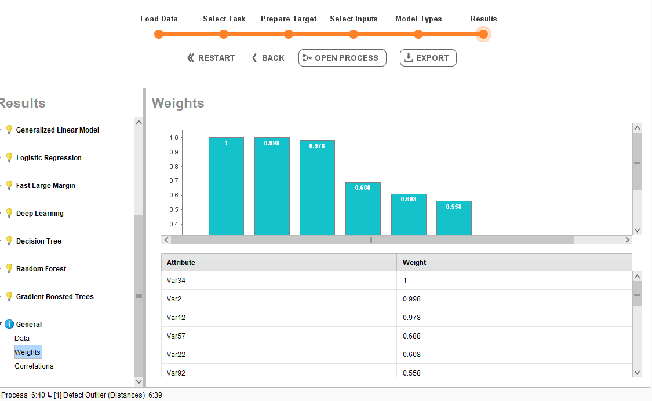

Slide 31
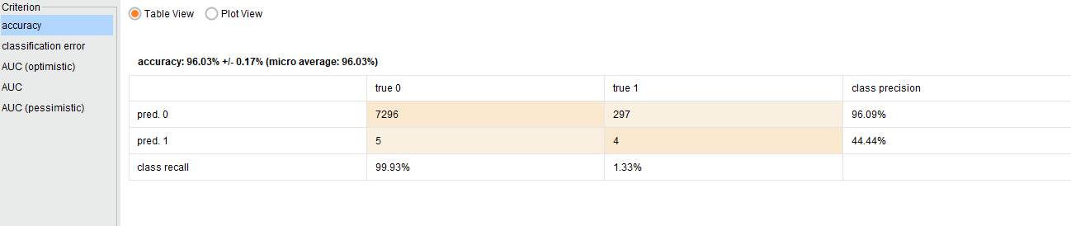
Dataset 3a Logistic Regression with Reduced Variables

Slide 32
Peirce’s Trichotomy of the Scientific Method
As Self Correcting Cycles Leading to the “Truth”
Multiple
Hypotheses
Abductive
Reasoning
Begin Next Cycle with Convergence on “Truth”
What are Testable Conclusions About Other Phenomenon That Must Be Reached For Each Hypothesis if True?
Controlled Experiments Based Upon Samples From a Population
Explanatory
Hypotheses
Experience
What Must
Happen If True?
Deductive
Reasoning
Begin Research
Assess Results of Application and Adjust Hypotheses
A Question
Sufficient Accuracy Reached to Take Action
Elimination
of False Hypotheses
(retroduction)
Test Predictive
Models
Execute Actions
Inductive
Reasoning
Assess Accuracy
reflects imaginative interpretation of results.
Economics Plays a Role in Sufficiency Decision.

Slide 33
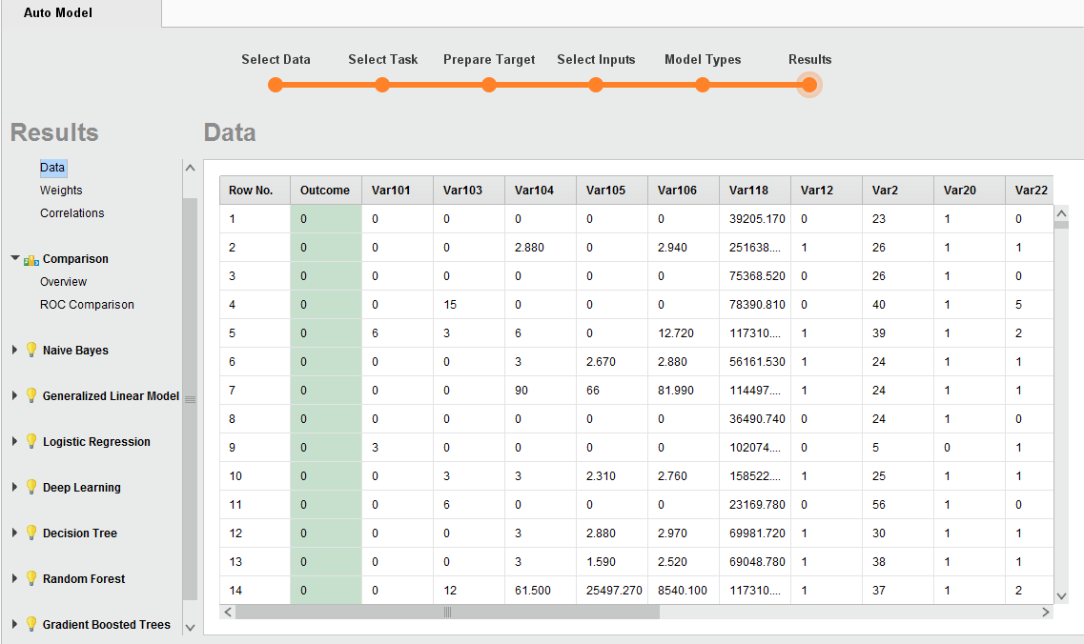
A potential problem

Slide 34
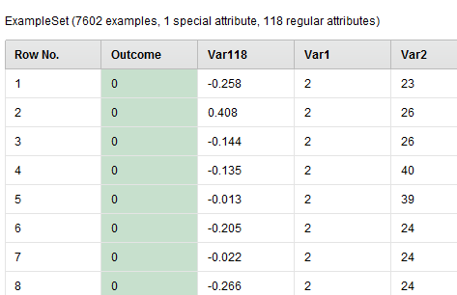
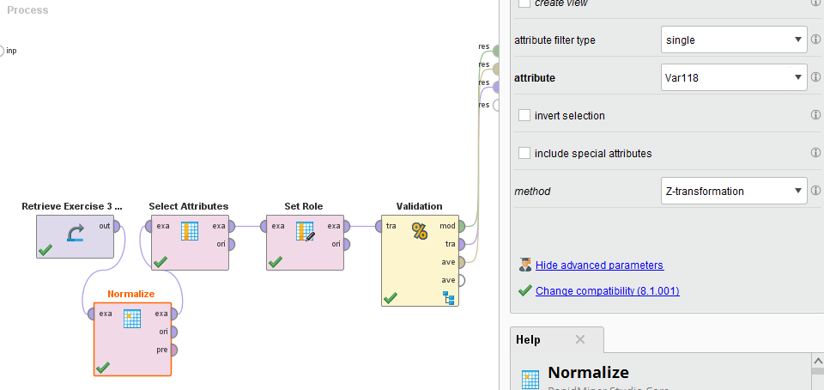
Normalizing

Slide 35
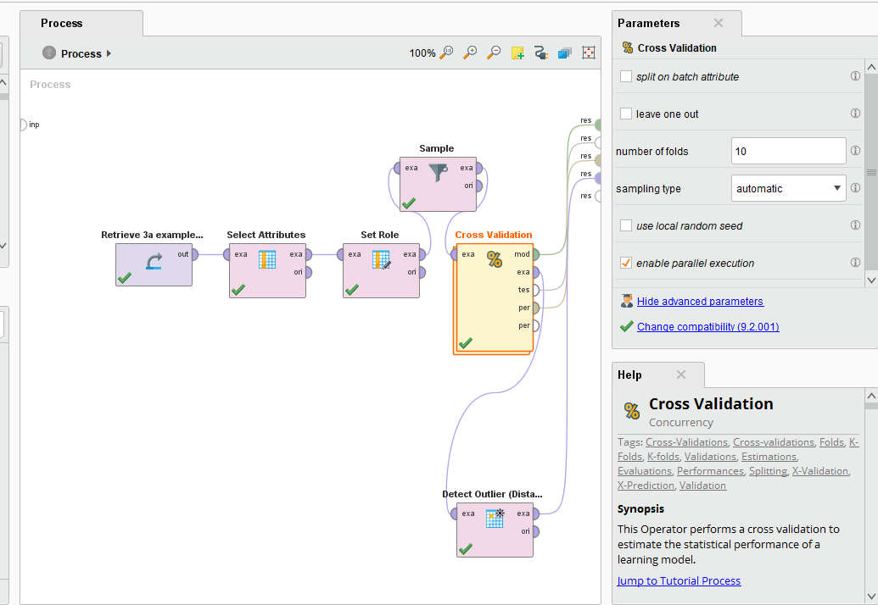

Slide 36
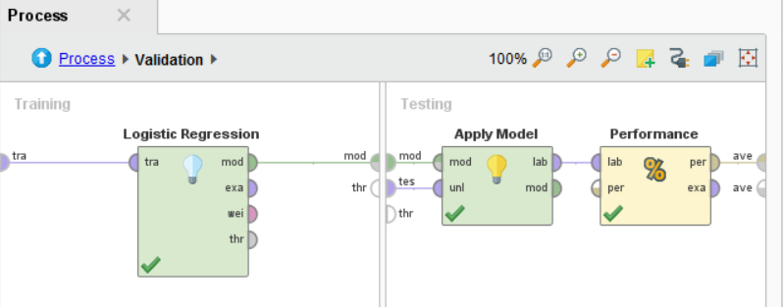

Slide 37
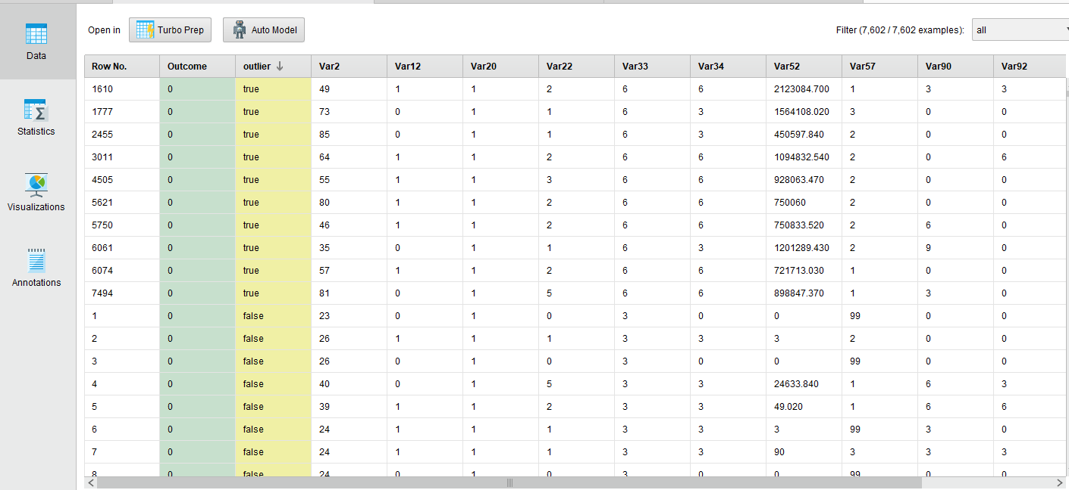
Two Major Variables Contain Outliers

Slide 38
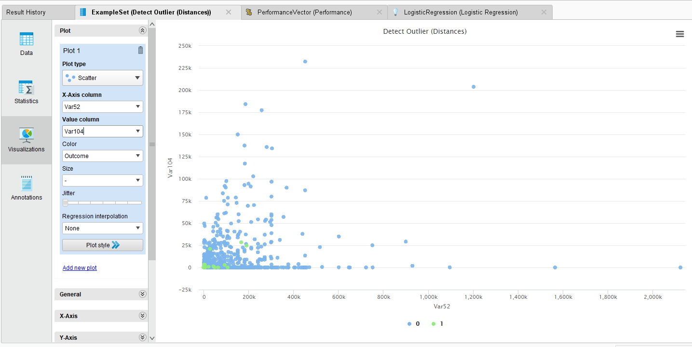
Analysis of Outliers Var 52 and Var 104 with Logistic Regression

Slide 39
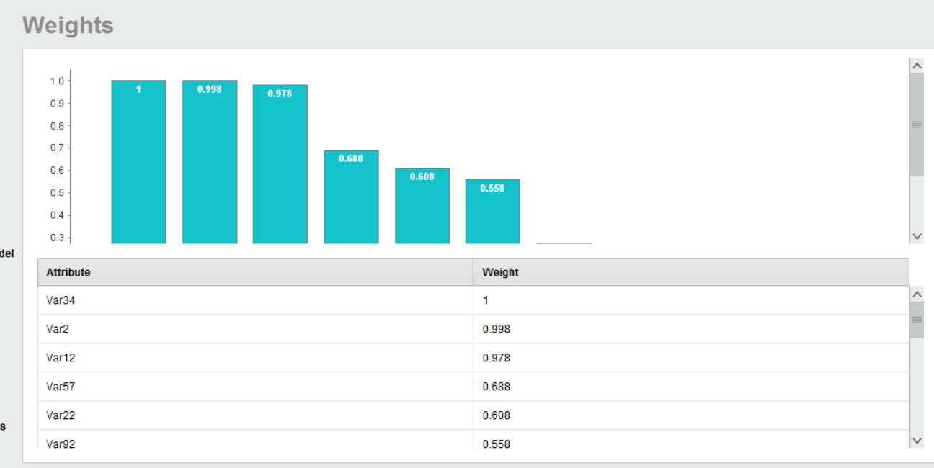
Insights as To Reducing Model Complexity And Getting Rid of Extraneous Predictors

Slide 40

Logistic Regression Coefficients Showing Top 10 Variables Being Reduced to Two
Significant

Slide 41


By Keeping Variables 34 and 92 We Are Able to Raise Recall A Bit.
It Gives Us A Sense That We May Be Able To Do Better Than Linear Models
Gradient Boosted Trees
Deep Learning

Slide 42

ROC Comparison Operator in Rapidminer

Slide 43

Exercise 3a Data
Logistic Regression (with or without regularization)
Gradient Boosted Trees

Slide 44

Automodel Perspective

Slide 45


Moving the Threshold to Deal With the Imbalance

Slide 46

By Adjusting the Threshold We are Moving Our Point on The ROC Envelope

Slide 47


….Which gives a similar result to doing our own balancing and adjusting the threshold

Slide 48

Using balanced sampling with threshold adjust…..

Slide 49

True Positive
Rate is Recall
We Let the System Optimize By Configuring Threshold on Your Own If the Situation Calls For it.
But Automodel does not do this.

Slide 50

Dataset 3b and Turbo Prep
Dataset 3b is Very Much Unprocessed, Let’s Go Through the Turbo Prep Feature

Slide 51


CRISP DM Phase 3—Data Preparation

Slide 52


Slide 53

After Cleansing, We Are Ready to Start Using Automodel

Slide 54

This Will Be Part of Your Homework Assignment for This Week.

Slide 55

Decision Trees
Non Parametric Methods

Slide 56
Shannon Made Information Gain A Statistical Construct
Probability/
Importance Index
Uniform Distribution Prior to Analysis
Maximum Entropy
Factor #21
Factor #115
Factor #1
Factor #116
Factor #2
Factor #20
Factor #22
Factor #23
Factor #117
Factor #118
……………………..
……………………………...
In dataset 3a We call these product “features”

Slide 57
Shannon Made Information Gain A Statistical Construct
Probability/
Importance Index
Prior to Analysis
Factor #21
Factor #115
Factor #1
Factor #116
Factor #2
Factor #20
Factor #22
Factor #23
Factor #117
Factor #118
……………………..
……………………………...

Slide 58


Probability of rolling heads given a “far” coin
Probability of rolling a heads given a “rigged” coin.
Entropy is a measure of “shuffledness” and unpredictability of information content
Consider normal versus a uniform distribution
Information Gain refers to the reduction of information entropy
Information Entropy and Information Gain

Slide 59

Returning to Dataset 2

Slide 60


Slide 61

Entropy Thought Exercise

Slide 62


Action of Decision Tree Splitting in Rapidminer for Dataset 2
The splits with the highest information gain (entropy reduction) come first

Slide 63

Decision Trees Van der Aalst Text Pages 94-100
860 total
Non-Leaf nodes-→ predictor variables
Supervised Learning Technique Aiming at Classification of Instances Based Upon Predictor Variables
One Categorical Response Variable Labeling the Data in the Form of a Tree
Classified to die before 70; 11 did not.
For the 665 persons not classified as dying before 70, we continue to ask questions.
Leaf nodes-→ values

Slide 64

First Entropy Calculation Died Young or Old
Supervised Learning Technique Aiming at Classification of Instances Based Upon Predictor Variables
One Categorical Response Variable Labeling the Data in the Form of a Tree

Slide 65


Slide 66
Splitting Procedure
If all of the training examples are the same classification (homogeneity), assign that classification to the node. Otherwise, pick an attribute to split on by performing the following test for each attribute that hasn't already been used:
compute the current entropy
compute the weighted average of the entropy in each subset partitioned by the value of the given attribute
compute the difference, and pick the attribute with the greatest change (i.e. the most information gain (entropy reduction) or purity from GINI index). For each value of the attribute,
repeat the process using only the training examples that have the given value for an attribute.

Slide 67




Slide 68


Slide 69

Several Good Videos About Classification and Regression Trees
https://www.salford-systems.com/resources/introductory-videos/introduction-to-tree-based-machine-learning-regression

Slide 70

Several Good Videos About Classification and Regression Trees
https://www.salford-systems.com/resources/introductory-videos/introduction-to-tree-based-machine-learning-classification

Slide 71


Single Trees Are Not Very Accurate Predictors Because of High Variance
Training Datasets Tend to Overfit-Bagging and Boosting Reduces This
Many Simple Trees for Learning Work Best

Slide 72

Exercise 3a -Decision Tree is Unbiased-Considers all the Data
But it has High Variance

Slide 73

Next We Move Into Ensemble Methods—Random Forest
Multiple Trees Reduce Variance
Trevor Hastie’s Discussion is Excellent
https://www.bing.com/videos/search?q=gradient+boosting+video&view=detail&mid=BC6160518DEF1ECD2379BC6160518DEF1ECD2379&FORM=VIRE

Slide 74

Bagging-Bootstrap Aggregation
Sampling with replacement
--observations in training dataset
--predictor variables
--no weighting in sample selection
--”Wisdom of Crowds” each tree individually is biased (does not consider all the data), but forest takes care of this while reducing the variance.

Slide 75


Slide 76

Decision Trees Tend to Overfit and Have high Variance.
So we look to correct these problems

Slide 77


Slide 78


Slide 79

Common Rapidminer Operator Structure

Slide 80


Not Only do We Gain Insights Toward Prediction But Variable importance As Well ---AKA Feature Weights

Slide 81


Slide 82


Weighted combination of models
During Training incrementally focuses on errors of previous learner to improve classification

Slide 83


Slide 84

From Trevor Hastie’s Video
The approach is Adaptive and Stagewise Additive resulting in multiple weighted samples.
It is a tree approach that is more serial than RF.
We wish to combine multiple “weak” learners to form an expert committee. Decision Stumps often chosen
Can reduce overfitting.

Slide 85

Gradient Boosted Machines

Slide 86


Slide 87

Dataset 3a---This is the kind of Dataset Where Ensemble Methods Are Very Helpful

Slide 88

Dataset 4--Result of a Query

Slide 89
Introducing Dataset 4 --Case Study: A Micro View
Exercise 4 Will Be Used To Provide Insight as To What is Causing Poor On-Time Delivery Performance
Project Performance Reporting:
Cost
Scope
Schedule
Quality
Resources
Risk
IT Performance Reporting:
Cost
Outages
System Performance
Incidents
Security
Audits
Projects
Operations Projects
IT Infrastructure & Networks
-Replacement
-Process Improvement
Operations Performance Reporting

Slide 90

Instructor’s Big Star
Dataset
SAP
https://1drv.ms/f/s!AsKbGD6G_CsKnDPpQ_muLiYBgVRd

Slide 91


Slide 92


Slide 93
Solutions to Complex Problems Such as On Time Delivery
Are Far Less Intuitive than “Churn” Types of Problems
Sales
Make
Deliver
Return
Source
Time

Slide 94

As a first step we build a decision tree for dataset 4. We wish to identify the root cause of on-time delivery for Big Star Assemblies Inc. This is a Cross Functional Problem

Slide 95

On Time Delivery

Slide 96

Gross Profit Margins

Slide 97

Late Flag=Label
As Will be Discussed in MDS 561 Your Instructor Prefers Gradient Boosting, Random Forest and Logistic Regression Over all Others, But It Depends Upon the Supplier’s Algorithm Used.

Slide 98

Note: The week 4 discussion board relates to question 2

Slide 99


Slide 100
Appendix

Slide 101

Rapidminer Decision Tree with Validation

Slide 102


Slide 103
Trevor Hastie’s 2014 Talk on Decision Trees, Random Forests and Boosting
https://www.bing.com/videos/search?q=gradient+boosting+video&view=detail&mid=BC6160518DEF1ECD2379BC6160518DEF1ECD2379&FORM=VIRE
Mark Landry H₂O World on Decision Trees, Random Forests and Boosting
https://www.bing.com/videos/search?q=gradient+boosting&&view=detail&mid=FBA1C133DB72650086B9FBA1C133DB72650086B9&&FORM=VRDGAR

